Slide 1

Agent Activity Chart
7/11/2022 11:22 PM
Print User : automation
Page 1 of 3

Slide 2
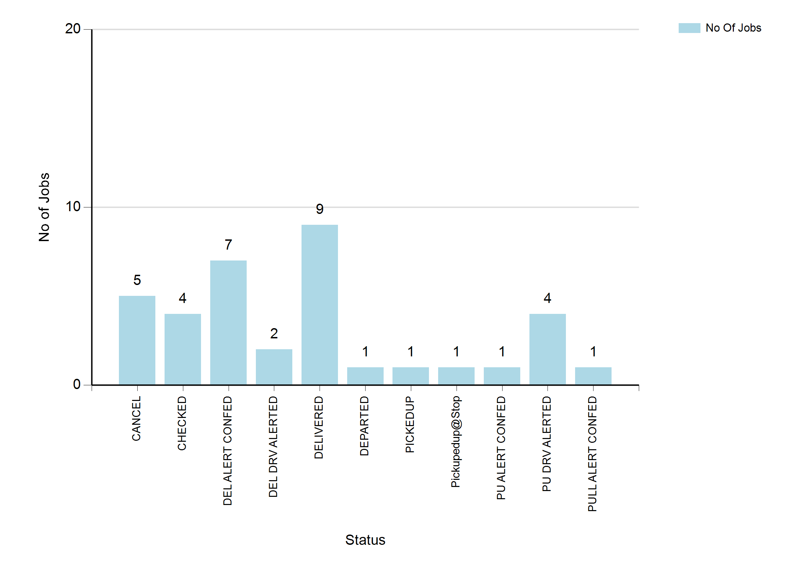
7/11/2022 11:22 PM
Print User : automation
Page 2 of 3

Slide 3
7/11/2022 11:22 PM
Print User : automation
Page 3 of 3

